Slide 1
Computer Graphics Rendering
Lecture 14: Scattering media
Kartic Subr

Slide 11
absorption
out-scatter
in-scatter
emission

Slide 12
Phase function

Slide 13


Slide 14
+
-

Slide 15
SIGGRAPH 2018 course slides
https://cs.dartmouth.edu/~wjarosz/publications/novak18monte-sig.html

Slide 16
Simplify calculations by adapting BRDFs?

Slide 17
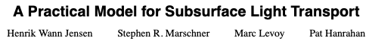
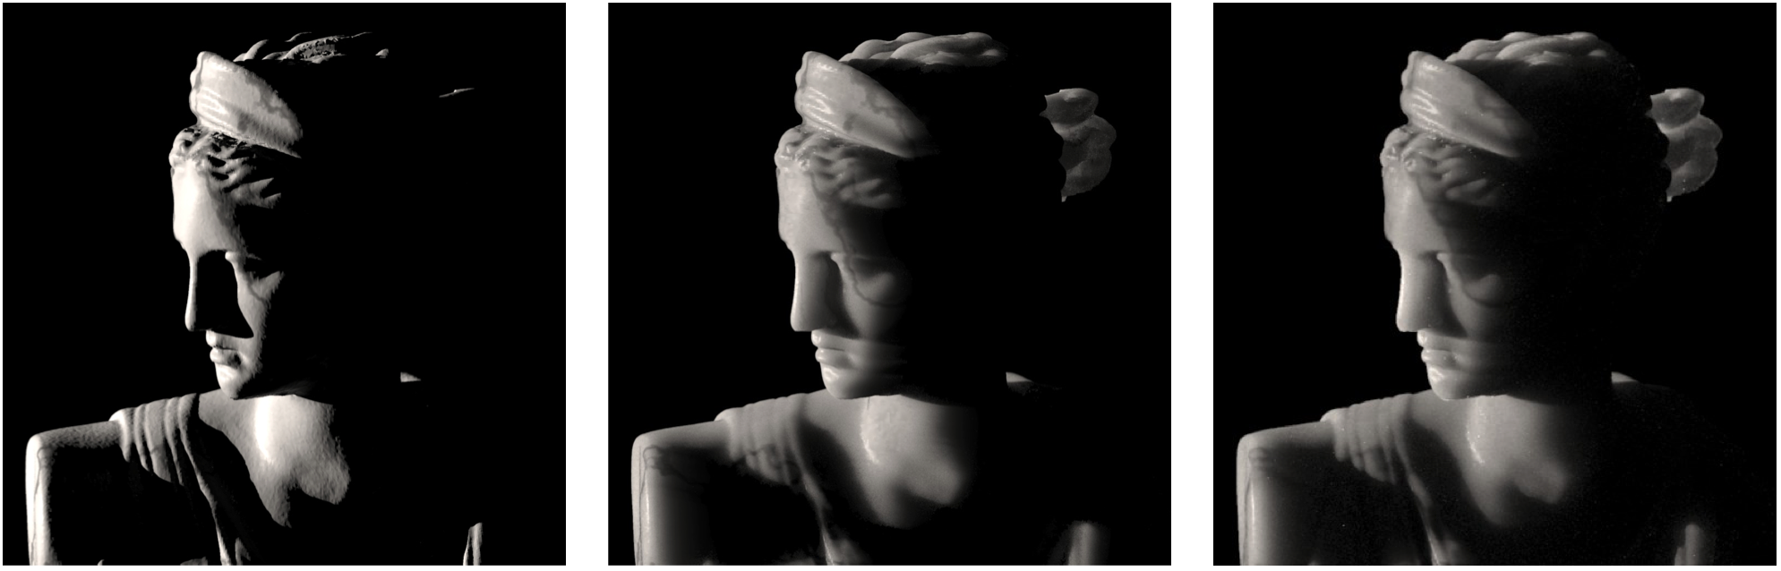
Siggraph 2001
BRDF
BSSRDF
Full simulation

Slide 18
https://www.pbrt.org/scenes-v3

